Slide 1
Machine Learning Explanations
Danrui Qi
Yating Wang
Yu Chen
School of Software
Tsinghua University
PVLDB 2016

Slide 2
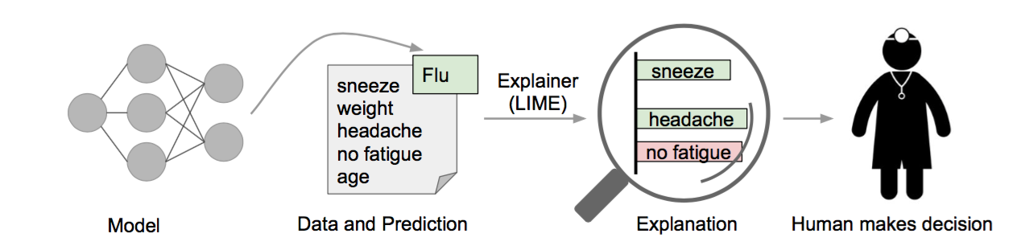
“Why Should I Trust You?” Explaining the Predictions of Any Classifier
Motivating Example
A model predicts that a patient has the flu
The symptoms in the patient’s history that led to this prediction are highlighted
Sneeze and headache are portrayed as contributing to the “flu” prediction
No fatigue is evidence against it
A doctor can make an informed decision about whether to trust the model’s prediction

Slide 3


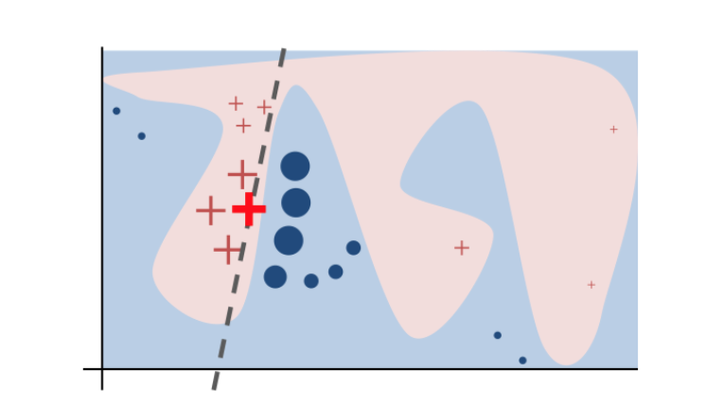

“Why Should I Trust You?” Explaining the Predictions of Any Classifier
LIME – Local Interpretable Model-Agnostic Explanations
Explanation produced by LIME (considering local fidelity and interpretability:
Sampling for Local Exploration
Sampling to minimize locality-aware loss
Sparse Linear Explanations
For linear classifier-based explanations

Slide 4
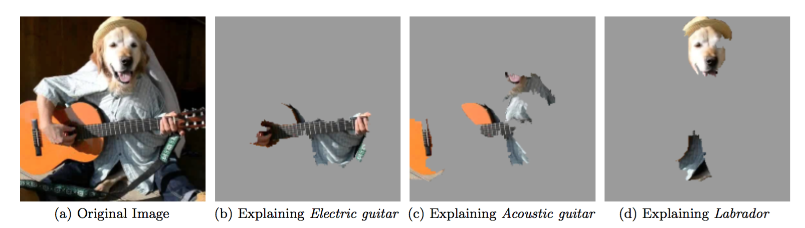
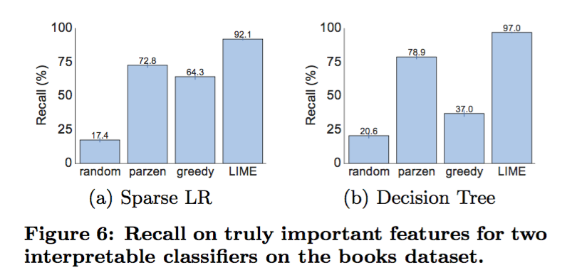
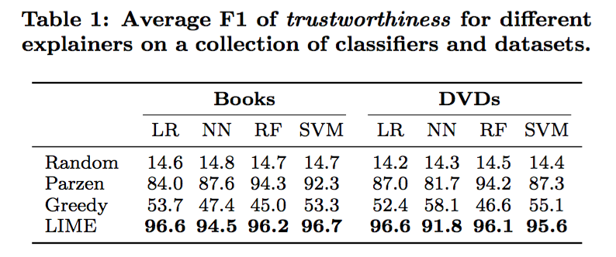
“Why Should I Trust You?” Explaining the Predictions of Any Classifier
Experiments

Slide 5
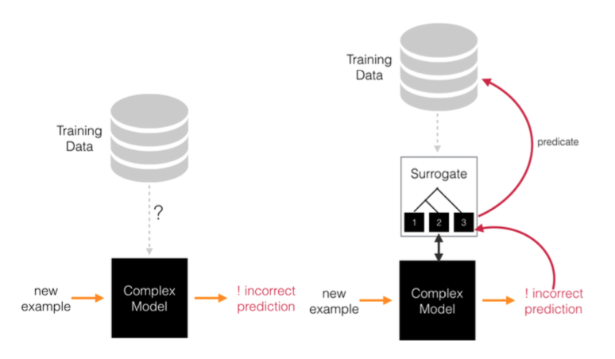
PALM: Machine Learning Explanations For Iterative Debugging
Motivation
Machine Learning model may make misprediction.
It is important to understand the failure cases in order to further improve model accuray
Framework
Propose a new model explanation technique that helps explain a model in term of partitions of the training dataset.
Two- part surrogate model:
Meta model: a decision tree -> partitions training data
A set of sub-models: approximate the patterns within each partition.
Return the most informative neighborhoods.

Slide 6
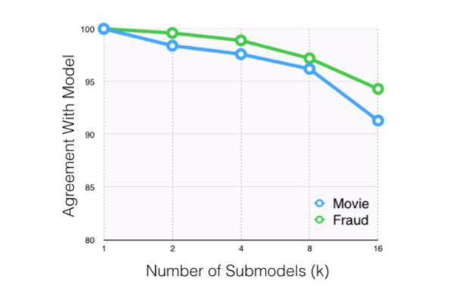
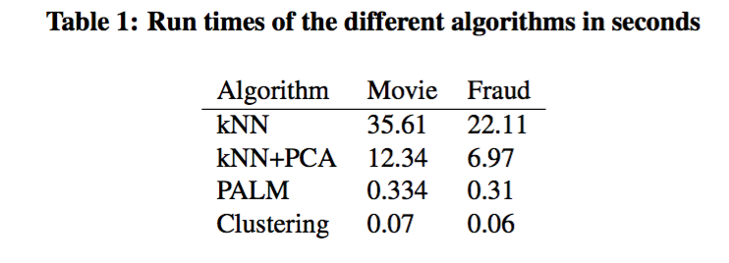
PALM: Machine Learning Explanations For Iterative Debugging
Applying PALM to a debugging task
Test point is mispredicted
Identify the partition it belongs to
Investigate that subset of the training data and its associated sub-model
Experiments

